Slide 1
Scheduled Tasks
another powerpoint

Slide 2
So basically...
What are scheduled tasks?
Run tasks at specific schedules
Upon an event
After x amount of time
Why are we learning about them?
Usually only for system maintenance
Hackers can take advantage of them

Slide 3
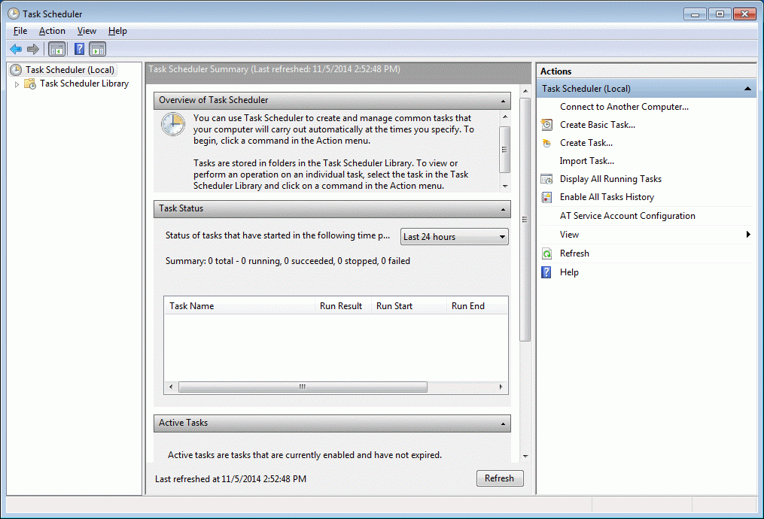
Task Scheduler
Run “taskschd.msc” or simply search “task scheduler”
Looks like this →

Slide 4
What does it do?
“Task Status” Section does not work as it says it does so ignore it
“Active Window” shows tasks that have been started before/ones that are waiting to be started
You can create tasks on the right side through a helpful wizard
On the right side it also allows you to “Show Hidden Tasks” under the “View” menu
Make sure this is checked

Slide 5
Finding Bad Tasks

Slide 6
What to do?
First identify a bad task
This requires your “CyberPatriot deduction skills”
“My recommendation is that you configure everything. When you restart your computer, look for any changes to your settings - if you find something, this MAY be indicative of a scheduled task ” ~Clement Chan
There could be other reasons why, but in these next examples we can assume that this is the case

Slide 7
Methods for searching
Other ways
Sysinternals has Autoruns, a GUI that allows you to view all tasks in a better way
https://docs.microsoft.com/en-us/sysinternals/downloads/autoruns
If you prefer scripting, know that:
Tasks are stored in C:\System32\tasks
Tasks are XML files that run Task.Actions.Exec.Command
Manually
Look at the attributes for each tasks
This includes name, trigger type, and action performed
While this is a pain, this is the simplest method to do so

